Slide 1

Department of Information Technology
NBA Accredited A.P. Shah Institute of Technology G.B.Road,Kasarvadavli, Thane(W), Mumbai-400615 UNIVERSITY OF MUMBAI Academic Year 2021-2022

Slide 2
A Project Presentation on CRICKET SCORE PREDICTION Submitted in partial fulfilment of the degree of Bachelor of Engineering(Sem-8)
in INFORMATION TECHNOLOGY By Pratik Dhumal – 19104031
Kushal Todi – 19104047
Ruchita Raut – 19104033
Under the Guidance of Prof. Geetanjali Kalme

Slide 3
1.Project Conception and Initiation

Slide 4
1.1 Introduction
Cricket score prediction is an area where the first innings score of a cricket match is predicted using some techniques.
We will be predicting the score of an match by considering various factors like runs scored, overs bowled, wickets taken, etc. The reason behind selecting these features is that we need to build a model that can understand the dynamicity of the cricket game. Therefore we are considering the factors which will be focusing on the dynamic nature of the cricket game.
Lots of people like watching cricket and they also like to predict the final score. Our Project focuses on an accurate prediction of cricket scores for matches considering the previous dataset available and also considers the various factors that play an important role in the score prediction.

Slide 5
1.2 Objectives
To improve the efficiency of players by analyzing the data the predict the future outcomes, which will help in effective strategic planning.
We can get all the latest news related to cricket.
3. The main aim is to predict the match outcomes using various parameters, the performance of each player based on the historical data.
4. In order to achieve reliable accuracy, we need to analyze a large amount of data.

Slide 6
1.4 Problem Definition
There is the need for a system that provides for an estimation or prediction of total runs which can be made using the current match statistics, for example, overs done, wickets gone or runs made in last 5 overs.

Slide 7
1.5 Scope
Can be applied in national and district level cricket leagues.
Can be applied in strategy planning of the team.
Can be used for formulating teams for specific matches.
Can used to provide hidden insights, such as batting partnerships and who is the best batting partner.

Slide 8
1.6 Technology stack
Frontend :
HTML
CSS
REACT
Backend :
Python
Machine Learning Algorithm
Flask

Slide 9
2. Project Design

Slide 10
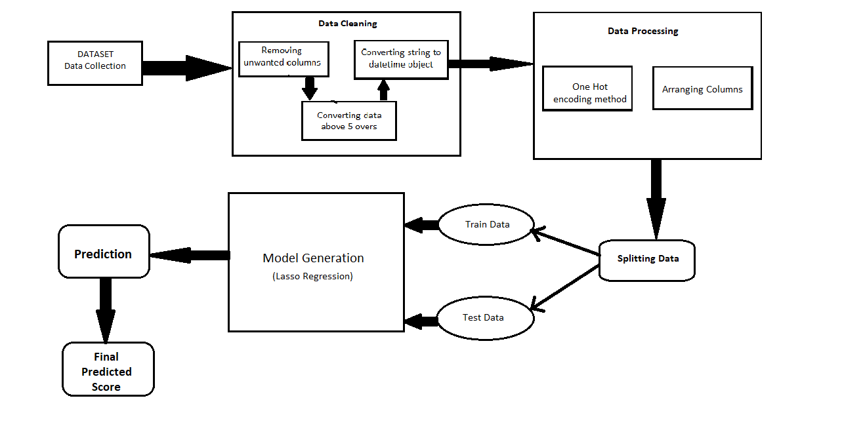
2.1 Proposed System

Slide 11
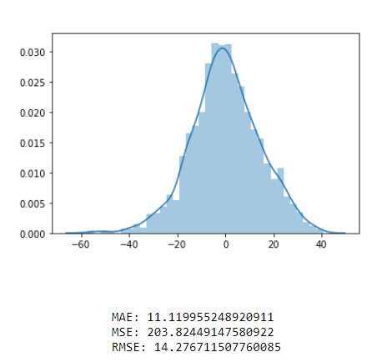
Lasso Regression: Lasso regression is a regularization technique. It is used over regression methods for a more accurate prediction. This model uses shrinkage. Shrinkage is where data values are shrunk towards a central point as the mean. The lasso procedure encourages simple, sparse models .

Slide 12
2.2 Design
1. Login /Register : The User has to enter the credentials to get signed in, to the website, or else register to get the access.
2. Home page: On this page the user will get to see the news related to all the matches. There will be the prediction button, by clicking on it the user will be redirected to the score prediction tab.

Slide 13
3. Prediction Module : This page is the main motto of our project cricket score prediction. In this the user has to input various parameters like teams name, overs bowled, the input of how many runs have been scored till now, and wickets fell. 4. Prediction Result Page: After clicking on predict button the predicted score range (result) will be shown on this page.

Slide 14
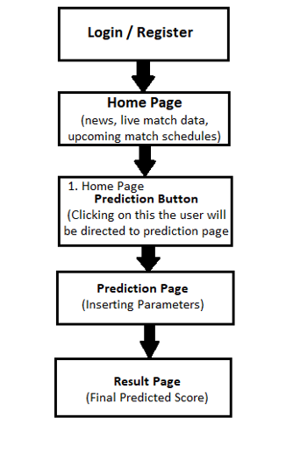
2.3 Design (Flow of Modules)

Slide 15
3. Implementation

Slide 16
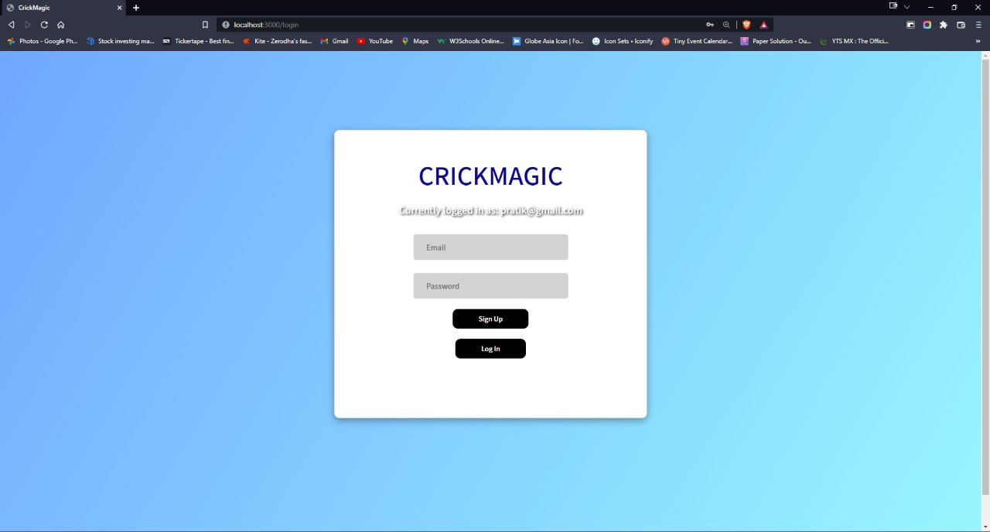
1. Login Page:

Slide 17
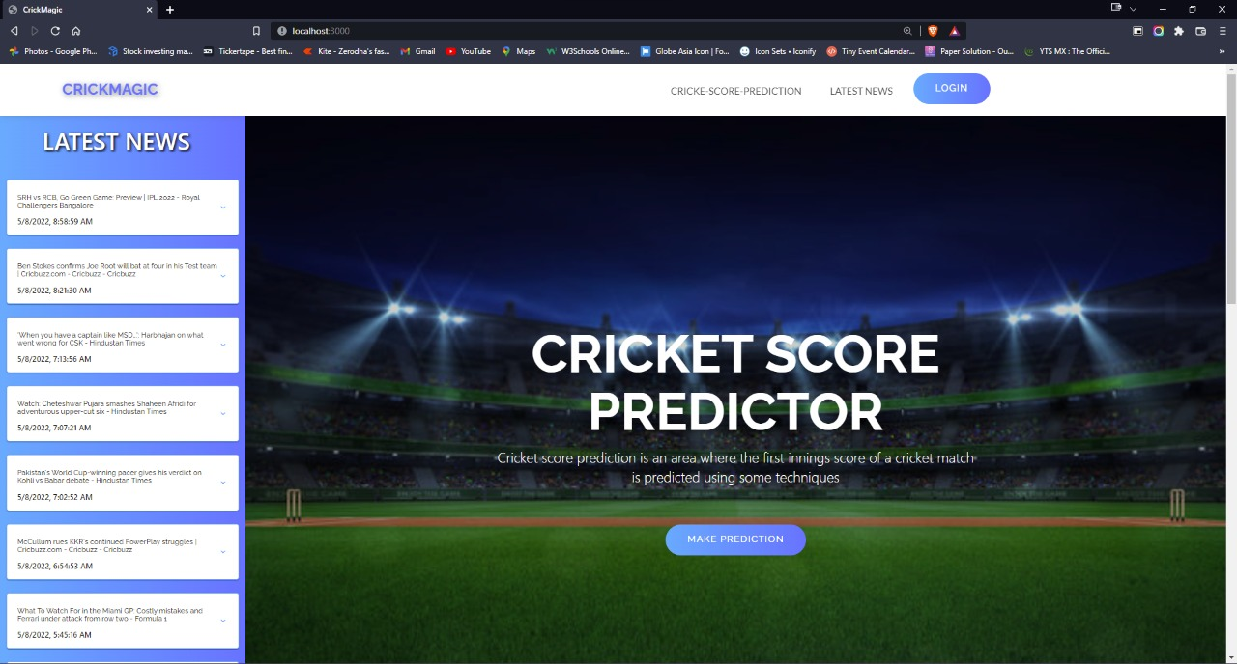
2. Home Page:

Slide 18
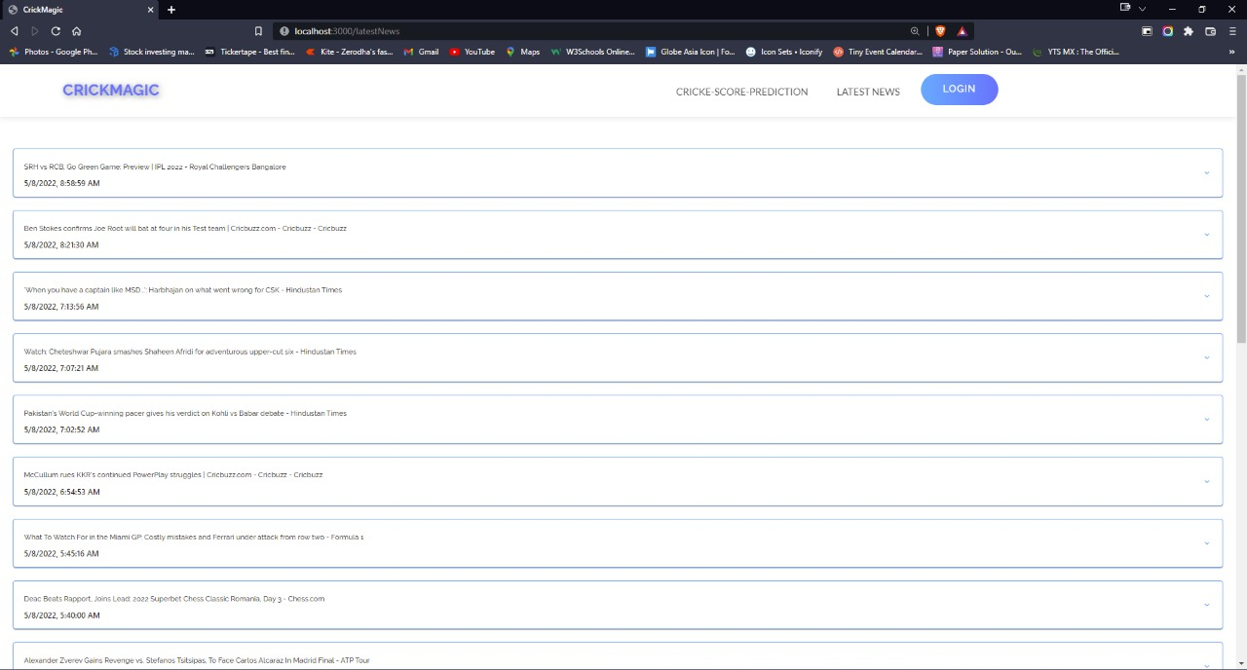
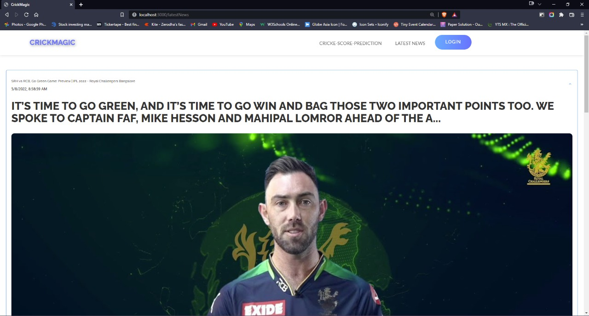
3. Latest News Section :

Slide 19
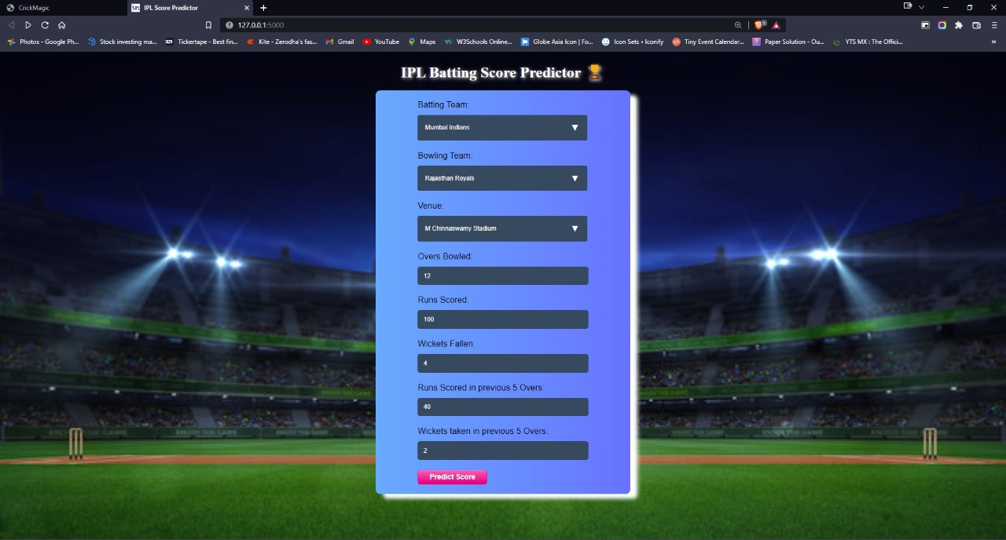
4. Prediction page :

Slide 20
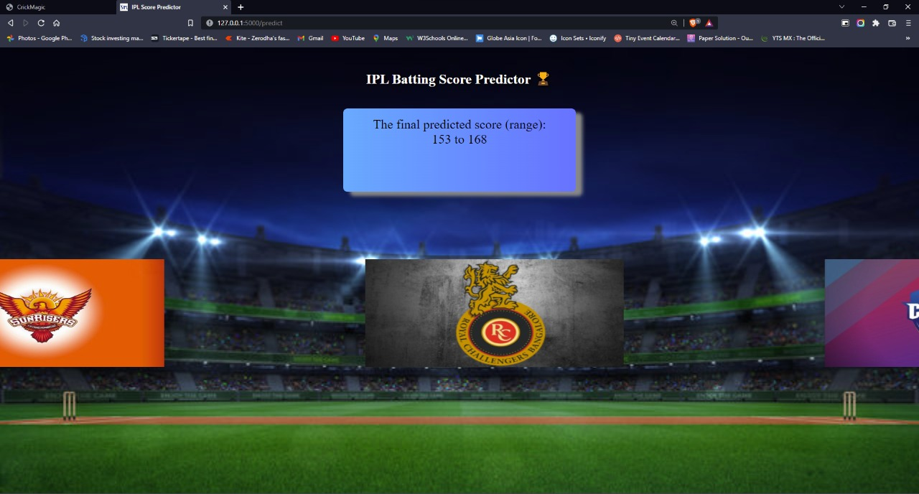
5. Prediction Result page :

Slide 21
4. Conclusion

Slide 22
Conclusion From the results, we can conclude that the Lasso Regression algorithm has the highest accuracy of the prediction. So, we are using the Lasso Regression model for the prediction purpose. In the future, we can implement a model for predicting the chasing probability. We can work on improving the accuracy of the model used in this project. Factors like venue, pitch, and the opponent team can be considered for the prediction.

Slide 23
References
Dhonge, Nikhil, et al. "IPL CRICKET SCORE AND WINNING PREDICTION USING MACHINE LEARNING TECHNIQUES.“
Patil, Nandkishor, and Dilip Dalgade. "CRICKET PREDICTION USING RANDOM FOREST REGRESSION."
https://www.geeksforgeeks.org/implementation-of-lasso-regression-from-scratch-using-python/
https://www.geeksforgeeks.org/implementation-of-lasso-regression-from-scratch-using-python/
https://towardsdatascience.com/which-evaluation-metric-should-you-use-in-machine-learning-regression-problems-20cdaef258e

Slide 24
Thank You

